Slide 1
Lecture9 Design Discipline III
Reading: Main text, Chp8&10; Sup text, Chp 11
Lek Hsiang Hui

Slide 2
Outline
Interaction Diagrams
Communication Diagrams
Sequence Diagrams
Visual Paradigm Demo

Slide 3
Interaction Diagrams
Interaction Diagrams
Communication Diagrams
Sequence Diagrams
Visual Paradigm Demo

Slide 4
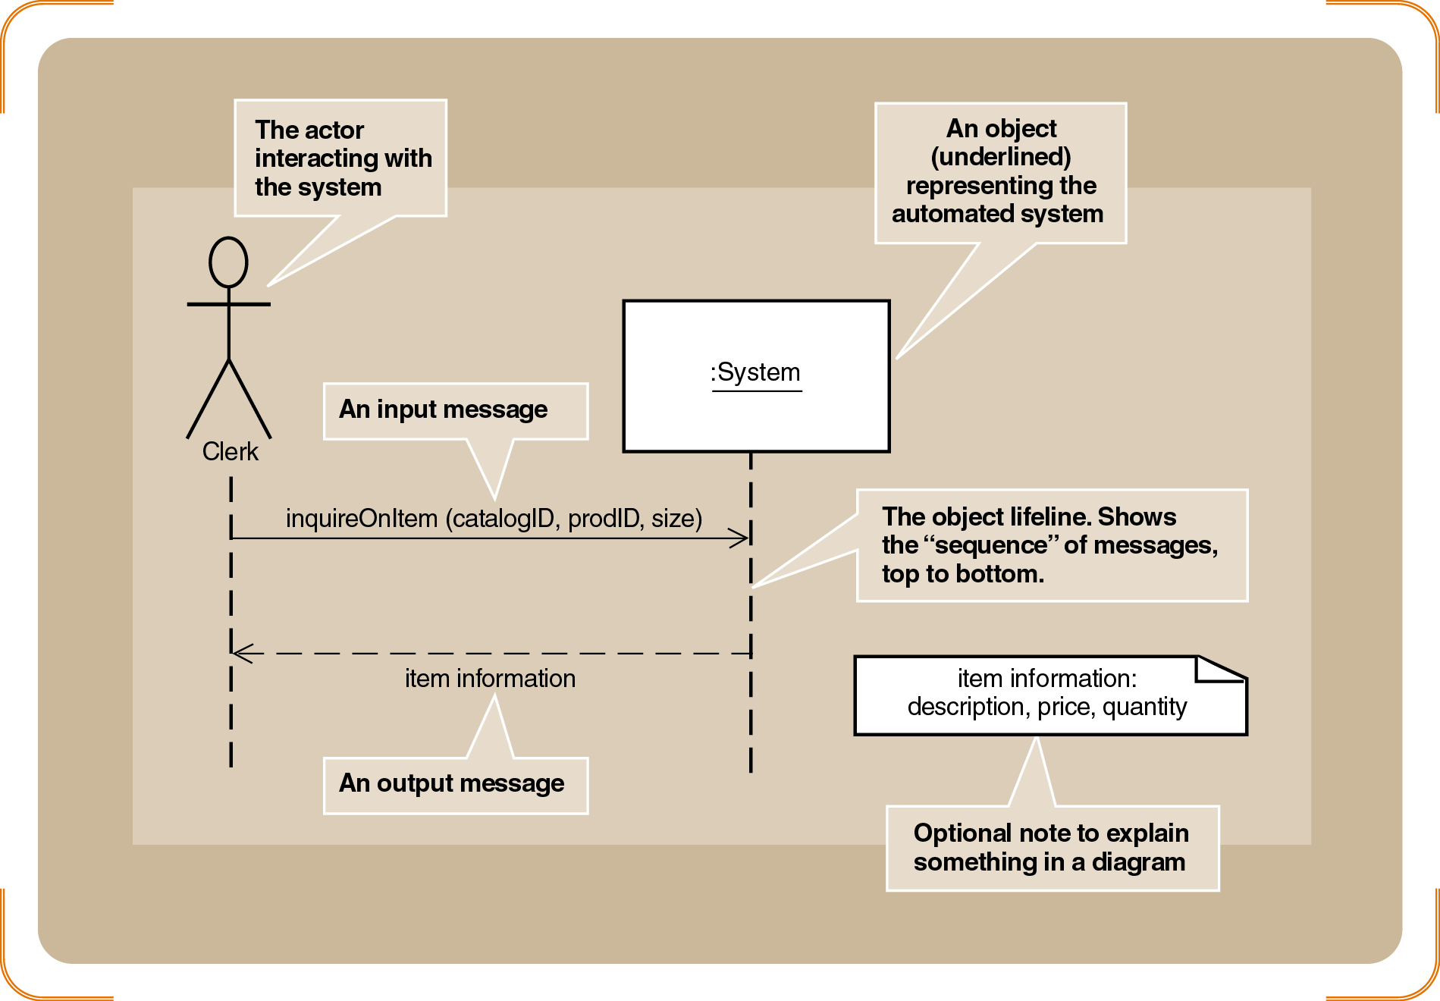
Recall: System Sequence Diagram

Slide 5

Recall: Use case realization
Use-case realization is the design of software that implements each use case

Slide 6
Use case realization
Use case realization is done through the development of interaction diagram

Slide 7
Design Use-Case Realization
Analyst needs to focus on the interactions between the classes
Design focus shifts from the big picture structural issues to dynamic interactions required to perform specific task

Slide 8

System behavior
Messages define the system behavior
This information is not explicitly shown using class diagrams

Slide 9

Interaction diagrams
2 types of interaction diagrams:
Communication diagram
Sequence diagram

Slide 10
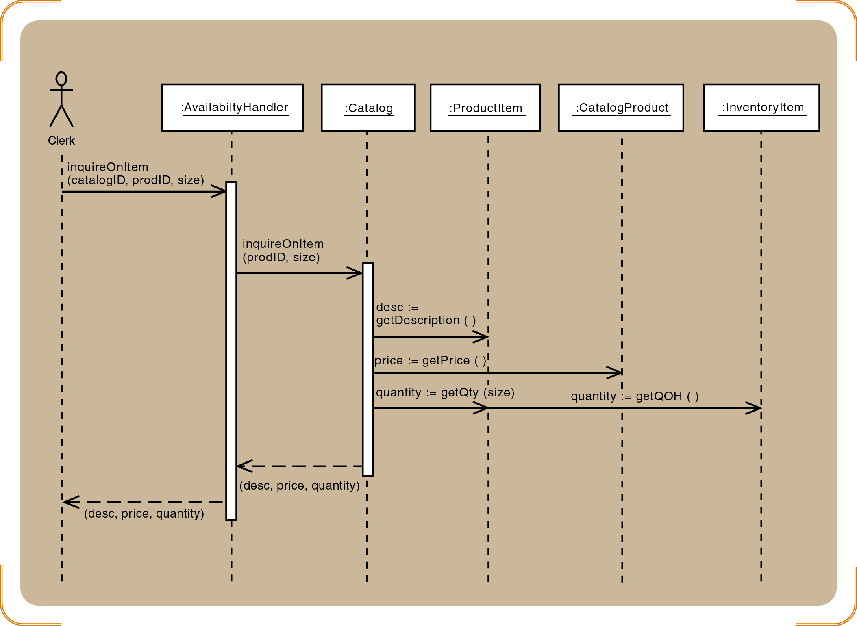
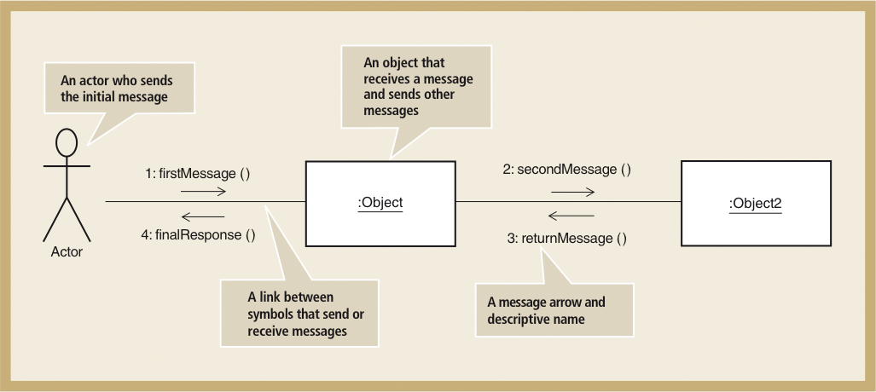
Communication Diagrams and Sequence Diagram
Communication Diagram
Sequence Diagram

Slide 11
Interaction Diagrams
Communication Diagram and Sequence diagram
Both are interaction diagrams
Both capture the same information
Process of designing is the same for both

Slide 12

So communication diagram or sequence diagram?
Which diagram to use is a matter of designer’s personal preference

Slide 13
Interaction Diagrams
Many designers prefer to use sequence diagrams:
Use case description follows a sequence of steps
Sequence diagram shows the time sequence
Communication diagrams (previously known as collaboration diagram)
shows how objects associate with each other

Slide 14
Interaction Diagrams
They are alternate representation of an interaction
You can convert one diagram to another diagram

Slide 15
Communication Diagrams
Interaction Diagrams
Communication Diagrams
Sequence Diagrams
Visual Paradigm Demo

Slide 16
Communication Diagram Symbols

Slide 17
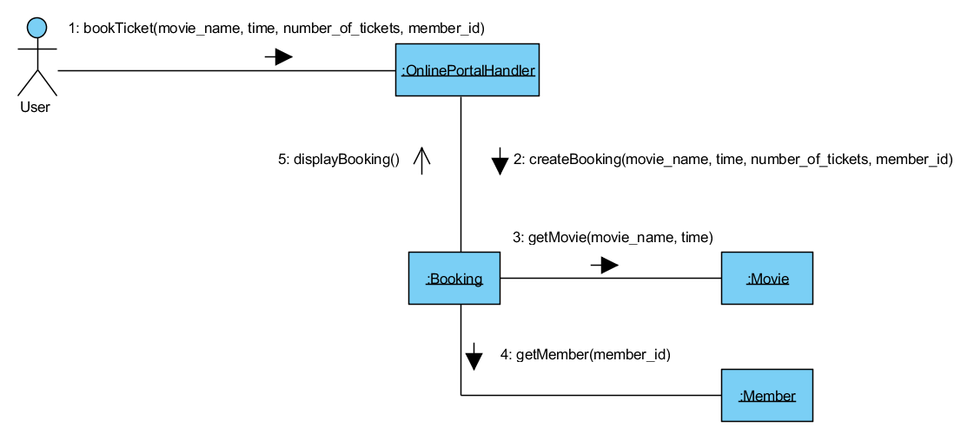
Communication Diagrams Example – Book Movie Tickets

Slide 18
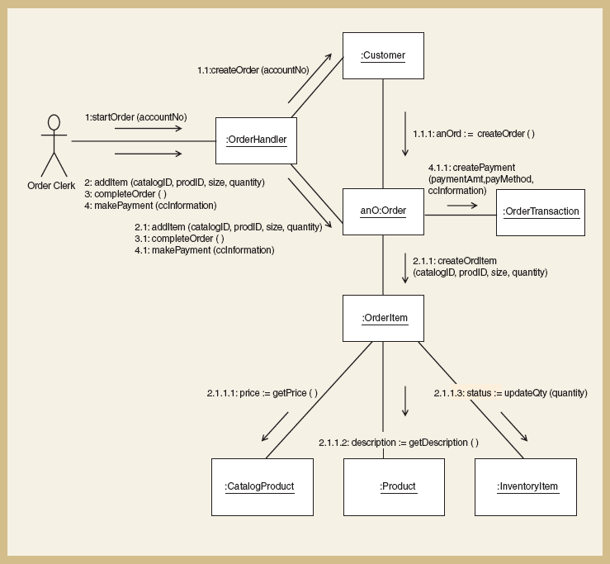
Communication Diagram Example – Create new phone order

Slide 19
Sequence Diagrams
Interaction Diagrams
Communication Diagrams
Sequence Diagrams
Visual Paradigm Demo

Slide 20
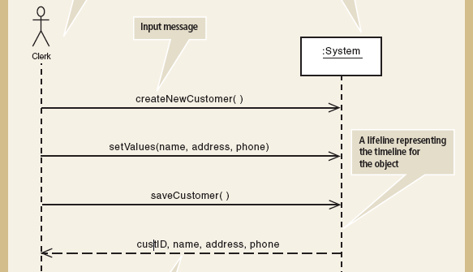
System Sequence Diagram
Create New Customer use case

Slide 21
Sequence Diagram
Difference between System Sequence Diagram and (non-system) Sequence Diagram
SSD models the interaction between the actor and the :System object, whereas the latter also shows the interaction between different objects in the systems
The exact operation calls, the specific method calls to enable it etc

Slide 22
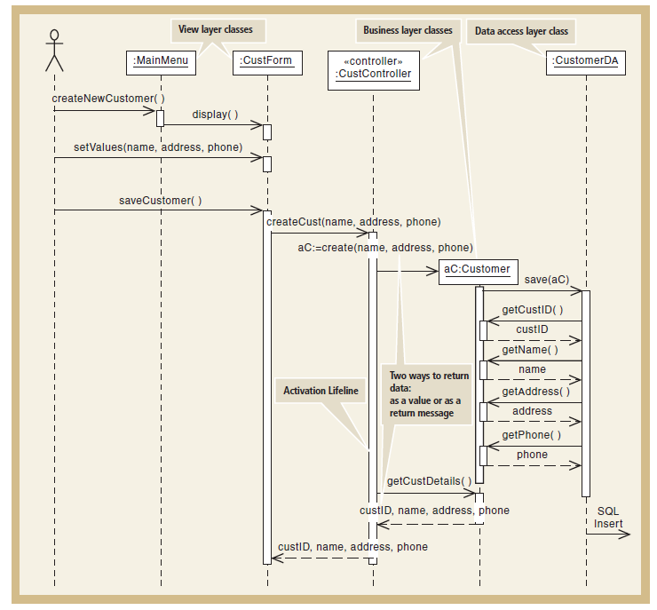
Sequence Diagram
Create New Customer use case
Notes:
Multi-layer/multi-tier architecture

Slide 23
First-Cut Sequence Diagram

Slide 24
First-Cut Sequence Diagram
Start with the elements from System Sequence diagram
Determine the potential objects required to carry out the use case
Replace the :System object with a use case controller object
Determine which other messages will be sent
Define the source and destination object for each message

Slide 25
Guidelines for Preliminary Sequence Diagram Development
Determine all of the internal messages that result from each input message
Define origin and destination objects
Identify the complete set of classes that will be affected by each message
Flesh out the components for each message
Iteration, true/false conditions, return values, and passed parameters

Slide 26
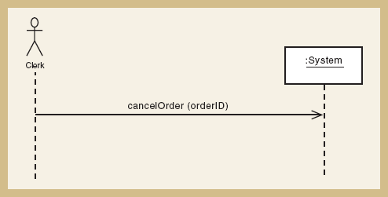
SSD for Cancel An Order
1. Start with the SSD Cancel An Order

Slide 27
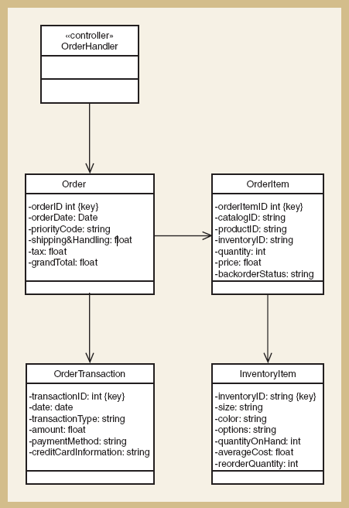
2. In order to determine the potential objects required to carry out
Cancel An Order
Look at the First Cut Design Class Diagram
And determine the potential objects required to carry out use case

Slide 28
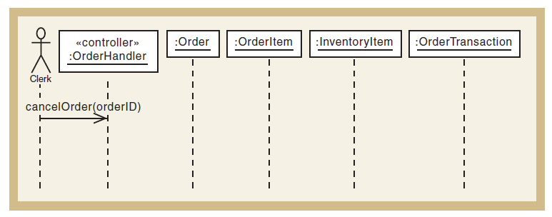
3. Replace :System with a use case controller object

Slide 29
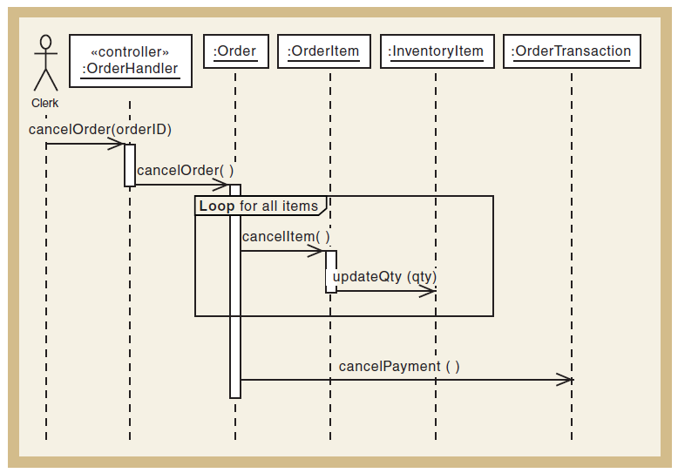
4. Determine the messages, the source and destination objects
cancelOrder(orderID)
First-Cut Sequence Diagram
cancelItem(itemID)
cancelPayment(paymentID)

Slide 30
Assumptions about First-Cut Sequence Diagram
The first-cut sequence diagram is created based on 3 simplifying assumptions
Perfect technology assumption
Do not include system interaction steps. e.g. Login/logout
Perfect memory assumption
Do not worry about object persistency - assume objects are in memory
Perfect Solution assumption
Do not worry about exception conditions

Slide 31

Assumptions about First-Cut Sequence Diagram
However in the complete sequence diagram, you should include every step
Remember what is the purpose of sequence diagram

Slide 32
Sequence Diagram Elements

Slide 33
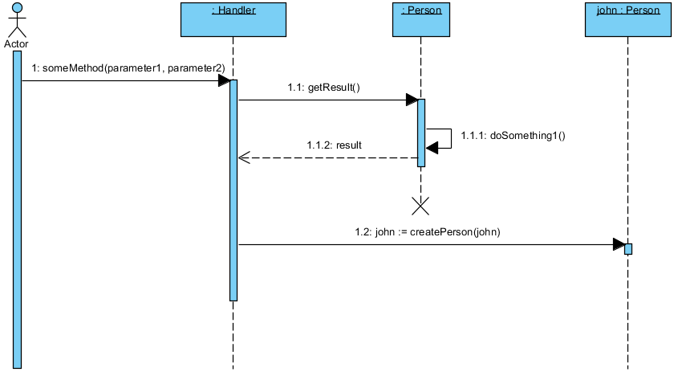
Sequence Diagram Elements
Actor

Slide 34
Sequence Diagram Elements
Message
Return Value
Explicitly indicates when the method returns the value
Return Value
Do not care when the method returns the value

Slide 35
Sequence Diagram Elements
Object
Make sure it is underlined
You can ignore the object name
Object
Sometimes it is useful to name the objects if you need to refer to an object (as return value or as parameters for another method call)

Slide 36
Sequence Diagram Elements
Self Message
Object call a method in its own class to perform some task required for the original method call

Slide 37
Sequence Diagram Elements
Activation Lifeline
Time Line

Slide 38
Activation Lifeline
Activation lifelines/boxes/Focus of Control indicates when an object is executing a method
This is useful to determine which object is in charge of a message sequence and the time duration
Some of the diagrams (in the book) did not include this but you should include this

Slide 39
Sequence Diagram Elements
Object is Destroyed

Slide 40
Another Example: Create New Phone Order

Slide 41
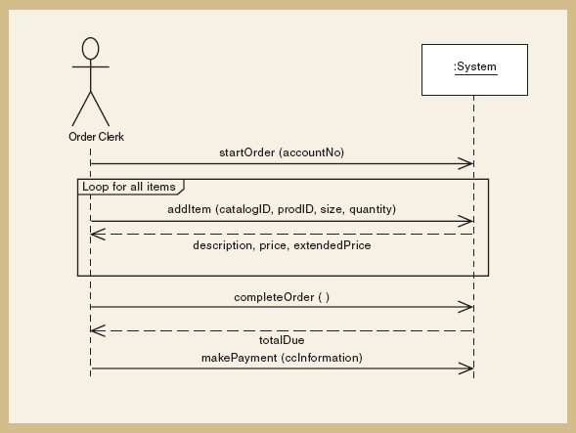
SSD for Create New Phone Order
1. Start with the SSD Create New Phone Order
item

Slide 42
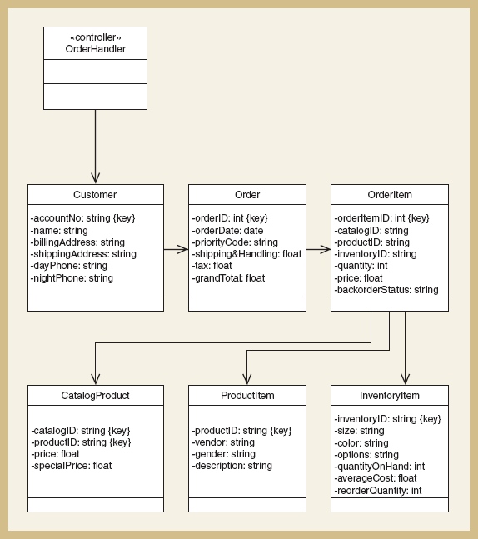
2. In order to determine the potential objects required to carry out
Create New Phone Order
Look at the First Cut Design Class Diagram
And determine the potential objects required to carry out use case

Slide 43
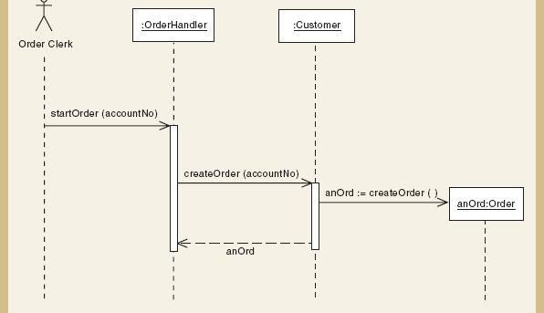
3. Replace :System with a use case controller object
4. Determine the messages, the source and destination objects
(for startOrder)

Slide 44
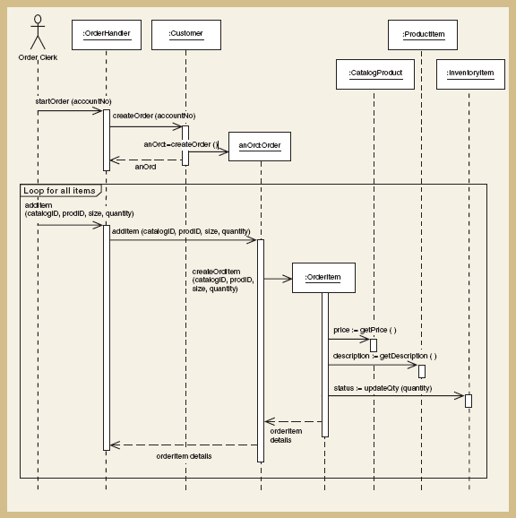
4. Determine the messages, the source and destination objects
(for startOrder and addItem)

Slide 45
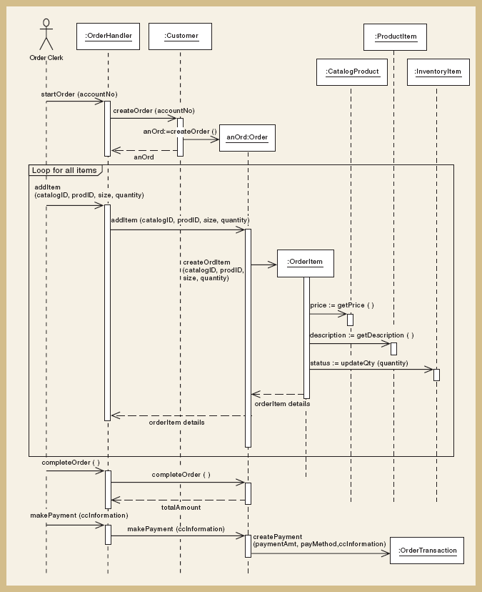
Complete Sequence Diagram

Slide 46
Developing A Multilayer Design

Slide 47
Developing a Multilayer Design
First-cut sequence diagram only focuses on the classes in the problem domain layer
Actual system requires other classes
Data Access Layer
No more perfect memory assumption
View Layer
User Interface

Slide 48
What is the benefits of a multilayer design?
Separation of responsibilities

Slide 49
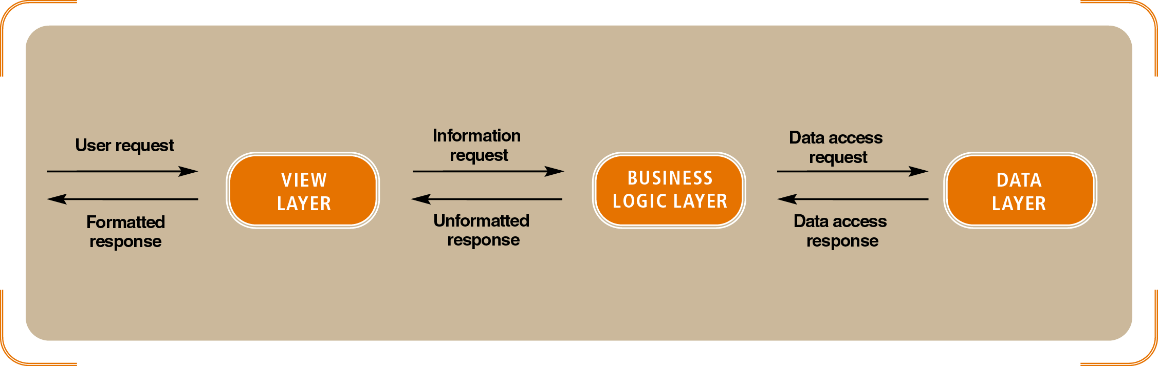
Data Access Layer
Note that the database server and business diagram server might not be on the same machine!

Slide 50
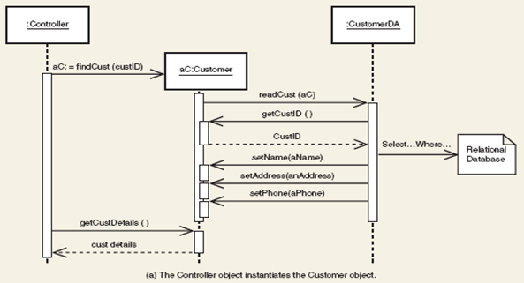
Data Access Layer
Method A
the controller call a method on the aC Customer object, passing it the custID
aC invokes the CustomerDA object, passing a reference to itself (aC)
Using the custID, it reads the data from the database and populates the fields in aC
Notes:
This figure illustrates 2 methods for instantiating a customer object in memory from database.
In method (a), the controller invokes the constructor for a :Customer object and passes it the custID. The customer constructor invokes the :CustomerDA object, passing a reference to itself. The customerDA first gets the custID from the customer object. Using the custID, it then reads the database and populates all the fields in aC. The referenceto the new customer object, referred to as aC, is then passed to the controller, and it proceeds with other messages that need to be passed to the customer object.
By ignoring the DA layer, the sequence diagram is the same as original diagram.
In method (b), the controller sends a message to the :CustomerDA object, passing a key or some other field values. The :CustomerDA object uses the key to access the database, and then it invokes a constructor for :Customer with data for the fields sent as parameters.

Slide 51
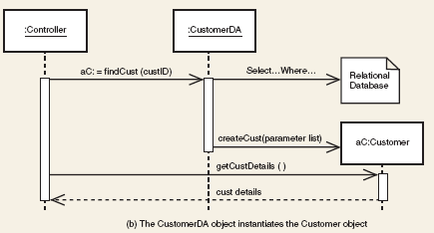
Data Access Layer
Method B
the controller call a method to the CustomerDA object, passing the custID
The CustomerDA object access the database and create the Customer object (aC) by supplying the values from the database
aC is then returned to the Controller
Notes:
This figure illustrates 2 methods for instantiating a customer object in memory from database.
In method (a), the controller invokes the constructor for a :Customer object and passes it the custID. The customer constructor invokes the :CustomerDA object, passing a reference to itself. The customerDA first gets the custID from the customer object. Using the custID, it then reads the database and populates all the fields in aC. The referenceto the new customer object, referred to as aC, is then passed to the controller, and it proceeds with other messages that need to be passed to the customer object.
By ignoring the DA layer, the sequence diagram is the same as original diagram.
In method (b), the controller sends a message to the :CustomerDA object, passing a key or some other field values. The :CustomerDA object uses the key to access the database, and then it invokes a constructor for :Customer with data for the fields sent as parameters.

Slide 52
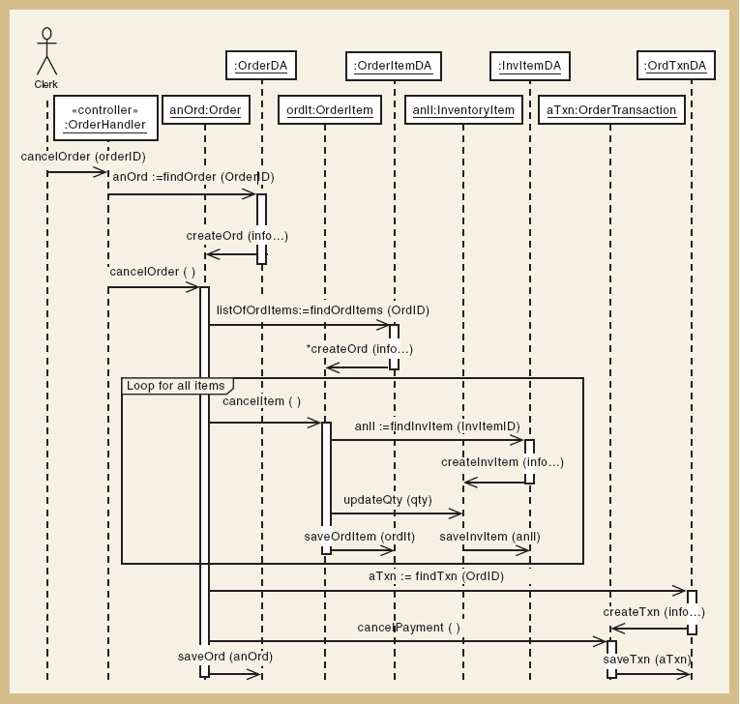
DA Layer for Cancel An Order

Slide 53
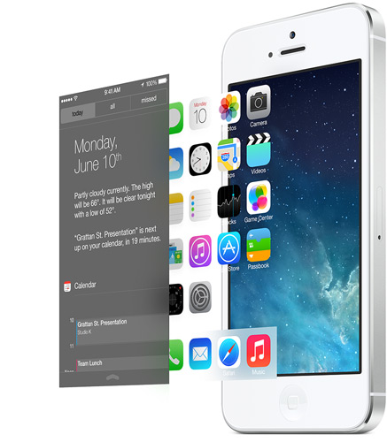
Designing the View Layer
Involves human-computer interaction
Interface designer takes the steps in use case description and develop the dialog design
The forms are then added as window classes in the seq diagram (View Layer)

Slide 54
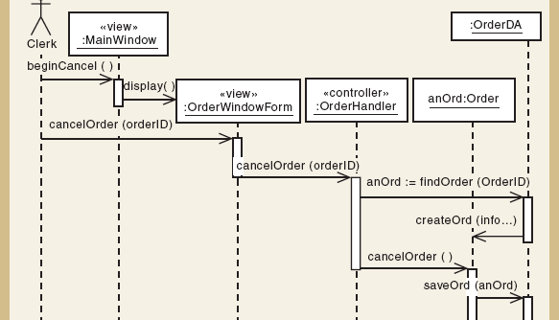
Partial Sequence Diagram with View and DA Layer for Cancel An Order

Slide 55
What’s Next?
Construction, Final Verification and Validation, and Closeout Phase

